Slide 1
Metal Oxide Semiconductor Field Effect Transistors
(MOSFETs)
Ref Book: Electronic Devices & Circuit Theory – Boylestad & Nashelsky

Slide 2
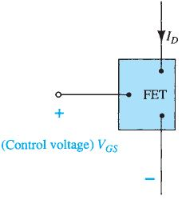
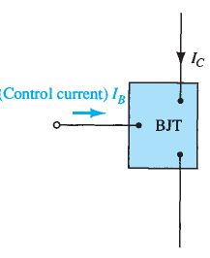

Field-Effect Transistor
Field-effect transistor (FET) is a 3-terminal device similar to a BJT transistor. 4-terminal devices are also available as FETs.
Primary Difference between the BJT & FET is that :
  BJT is a current-controlled device
  FET is a voltage-controlled device.
For both the devices, the output current is controlled by a parameter of the input circuit:-
  In a BJT, Collector Current I_{C} is a direct function of Base Current I_{B}.
  In an FET, the Drain current I_{D} is a function of the Gate-Source voltage V_{GS} applied at the input.
BJT has two variants: npn and pnp.
FET has two variants: n-channel and p-channel
BJT is a bipolar device as the flow of current is caused by majority charge carriers as well as minority charge carriers.
FET is a unipolar device as the current flow is caused by only one type of charge carriers i.e. by electrons in n –channel device or by holes in p-channel device.
In a FET, an electric field is established by the charges present, which controls the conduction path of the output circuit.

Slide 3
Field-Effect Transistor
One of the most important characteristics of the FET is its high input impedance.
Input resistance of FETs ranges from 1 MΩ to several hundred MΩs and far exceeds the typical input resistance levels of the BJT —it is an important requirement in design of amplifier systems.
BJT transistor has a much higher sensitivity to changes in the applied signal i.e. the variation in output current is far more for BJTs than for FETs for the same change in the applied voltage. For this reason: Typical ac voltage gains for BJT amplifiers are greater than for FETs.
FETs are more temperature stable than BJTs.
FETs are usually smaller than BJTs and are therefore useful in integrated-circuit (IC) chips.
The construction characteristics of some FETs make them more sensitive to handling than BJTs.
There are three Main types of FETs :
  Junction field-effect transistor (JFET),
  Metal–oxide–semiconductor field-effect transistor (MOSFET)
  Metal –semiconductor field-effect transistor (MESFET)
MOSFETs are of two types:
  Depletion Type MOSFETs (DE MOSFET)
  Enhancement Type MOSFETs (EN MOSFET)
MOSFETs are used in the design and construction of ICs for digital computers.
Have high thermal stability
MESFET: It is quite similar to a JFET in construction.
The difference is that instead of using a p-n junction for a gate, a Schottky (metal
semiconductor) junction is used.
Hence, main advantage of the MESFET over the MOSFET is its speed (larger bandwidth).

Slide 4
MOSFETs
Depletion Type Enhancement Type
n- Channel P-Channel
n- Channel P-Channel

Slide 5
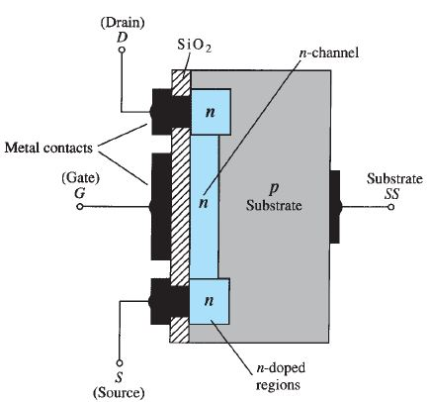
n-Channel Depletion Type MOSFET
Basic Construction :A slab of p -type substrate, is taken on which the device is constructed.
Two n-type regions joined by a n-channel are created in the substrate by introducing n-type impurities.
Thereafter an insulation layer of SiO₂ is deposited on the substrate. Metal contacts are created for drain and source.
Gate is connected to a metal contact surface but remains insulated from the n -channel by a very thin SiO₂ insulation layer. SiO₂ layer acts as a dielectric for setting up an electric fields within the dielectric.
Insulating layer of SiO₂ results in high input impedance of the device.
Metal–oxide–semiconductor FET has metal for the drain, source & gate connections and oxide for SiO₂ insulating layer and semiconductor for the basic structure on which the n - and p -type regions are diffused.
Source
Gate
Drain
SiO₂
n
n
n
P-Substrate

Slide 6
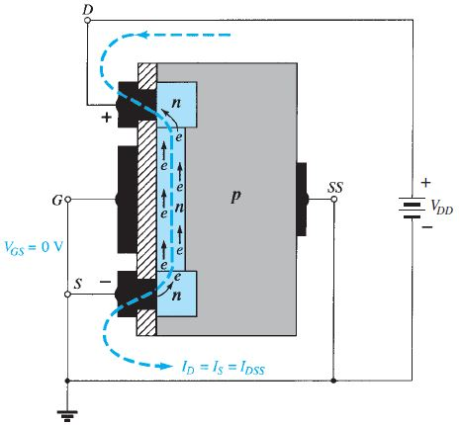
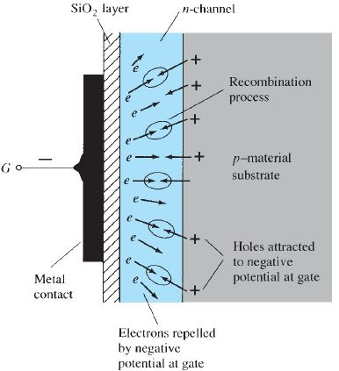
n-Channel Depletion Type MOSFET
Basic Operation and Characteristics (when V_{GS} = 0V)
Gate-to-source voltage V_{GS} is set to 0 V and a positive voltage V_{DD} is applied across the drain-to-source terminals.
Drain
This results in attraction of free electrons of n-channel towards positive drain voltage causing current in the channel.
Gate
Resulting current at V_{GS}=0 V is labeled as I_{DSS}.
As V_{DD} is made more and more positive,
  the depletion region at the drain end increases due to upper pn-junction becoming more reverse biased causing the channel to become narrower at the drain end.
Source
  Finally, pinch off occurs at which the drain current reaches saturation level and becomes constant.
When V_{GS} < 0V
Negative potential V_{GS} at the gate repels electrons toward the p -type substrate and attracts holes from the p -type substrate.
Depending on the magnitude of the negative bias of V_{GS}, a level of recombination between electrons and holes occurs which reduces the number of free electrons in the n -channel available for conduction.
The more negative the bias, more electrons are pushed away from the channel towards the substrate and holes are attracted from the substrate, thus higher is the rate of recombination.
Resulting level of drain current is therefore reduced with increasing negative bias for V_{GS} , towards the pinch-off voltage V_{P} . This is clear from transfer curve also (refer next slide)

Slide 7
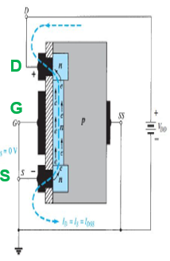
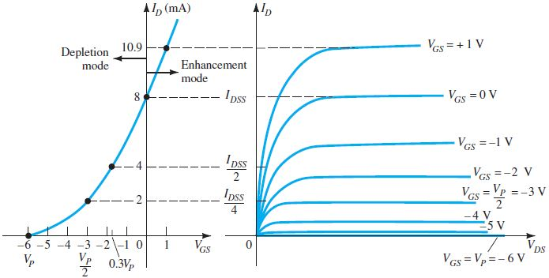
n-Channel Depletion Type MOSFET
When V_{GS} > 0V: Application of a positive V_{GS} (gate-to-source) voltage enhances the number of free carriers in the channel as compared to when V_{GS}=0 V, as it establishes new carriers through the collisions resulting between accelerating particles.
As V_{GS} continues to increase, the drain current increases at a rapid rate. However, maximum drain current rating should not be exceeded.
For this reason, the region of positive gate voltages on the drain or transfer characteristics is referred to as the enhancement region, with the region between cutoff and the saturation level of I_{DSS} referred to as the depletion region (V_{GS} is negative).
Spacing between the V_{GS}=0 V and V_{GS}=+1 V curves gives an indication of amount of change in current with change in V_{GS}.
Transfer Characteristics are drawn between I_{D} & V_{GS} for fixed value of V_{DS}.
Drain Current Characteristic curve is drawn between I_{D}& V_{DS} at different levels of V_{GS}.

Slide 8
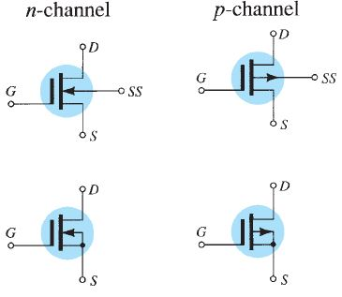

Symbols for Depletion-type MOSFETs
The graphic symbols for an n - and p -channel depletion-type MOSFETs are as shown
Two symbols are shown for each type of channel to reflect the fact that in some cases the substrate (SS) is externally available, whereas in others it is not.
The vertical line representing the channel is connected between the drain and the source and is “supported” by the substrate.

Slide 9
Enhancement Type MOSFET

Slide 10
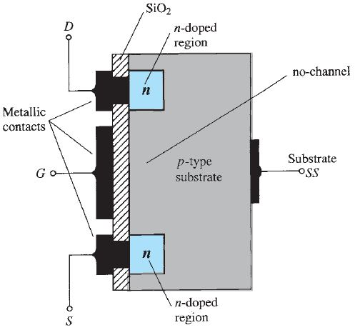
n- Channel Enhancement Type MOSFET
Basic Construction:
A substrate of p -type material is formed from a silicon base.
As with the depletion-type MOSFET, the substrate may be internally connected to the source terminal, or a fourth lead (labeled SS) is made available for external control of its potential level.
Two n – type doped regions are created in the substrate by diffusing n-type impurities. One of the regions is called Drain and other is called Source.
The source and drain terminals are connected to n -doped regions through metallic contacts to.
The SiO₂ layer (thin layer – 1000Aº) isolates the gate metallic platform from the substrate.
The primary difference between the depletion-type and enhancement-type MOSFETs is absence of channel between the two n -doped regions.

Slide 11
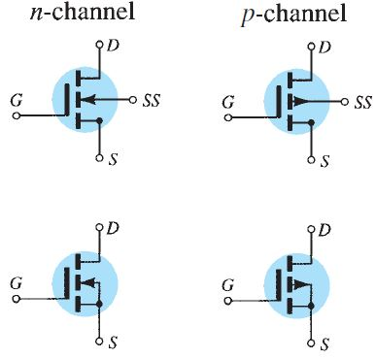

Symbols of Enhancement Type MOSFETs
Symbols
The graphic symbols for the n - and p -channel enhancement-type MOSFETs are shown.
The dashed line between drain and source reflects that a channel does not exist between the two under no-bias conditions.
It is the only difference between the symbols for the depletion-type and enhancement-type MOSFETs.

Slide 12
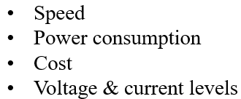

Types of Logic Families
Entire range of Digital ICs are fabricated using either
Bipolar Devices or MOS Devices or a combo of the two (Bi-MOS).
Bipolar Families:
  Diode Logic (DL), Resistor Transistor Logic (RTL), Diode Transistor Logic (DTL), Integrated Injection Logic (I²L) ....Obsolete
  Transistor Transistor Logic (TTL) -- Widespread use
  Emitter Coupled Logic (ECL) -- Used for High Speed applications
MOS Families:
  PMOS family (using P-channel MOSFETs), ….........Obsolete
  NMOS family (using N-channel MOSFETs),
  CMOS family (using both N- and P-channel devices).
Bi-MOS logic family uses both bipolar and MOS devices.
These families vary by:

Slide 13
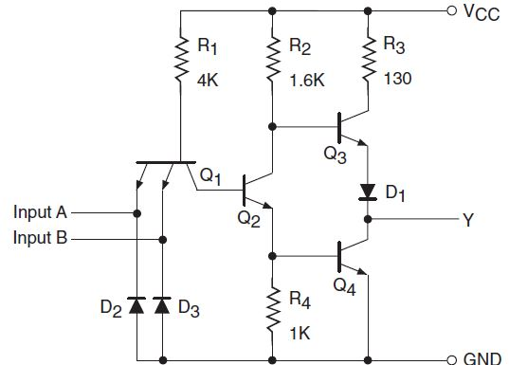
TTL – NAND Gate
TTL “Transistor Transistor Logic”, family is implemented with bipolar process technology that combines NPN transistors, PN junction diodes and diffused resistors in a single monolithic structure.
The NAND gate is the basic building block of this logic family.
Adjacent figure shows the internal schematic of a standard TTL NAND gate, which is a quad two-input NAND gate.
Circuit Operation:
Transistor Q₁ is a two-emitter NPN transistor, which is equivalent to two NPN transistors with their base and emitter terminals tied together.
The two emitters are the two inputs of the NAND gate.
Diodes D₂ and D₃ are used to limit negative input voltages.

Slide 14
TTL – NAND Gate
When both the inputs are HIGH , the current flows through the base-collector junction of transistor Q₁ into the base of transistor Q₂. Transistor Q₂ is turned ON to saturation, with the result that transistor Q₃ is switched OFF and transistor Q₄ is switched ON. This produces a logic LOW at the output, with V_{OL} being 0.4 V maximum.
When Output 'Y' is LOW, Q₄ is in saturation and Q₃ may conduct slightly in the absence of D₁. Diode D₁ prevents transistor Q₃ from conducting even a small amount of current.
When either of the two inputs or both inputs are in the logic LOW state, the base-emitter region of Q₁ conducts current, driving Q₂ to cut-off in the process. When Q₂ is in the cut-off state, Q₃ is driven to conduction and Q₄ to cut-off. This produces a logic HIGH output with V_{OH}(min.) = 2.4 V .

Slide 15
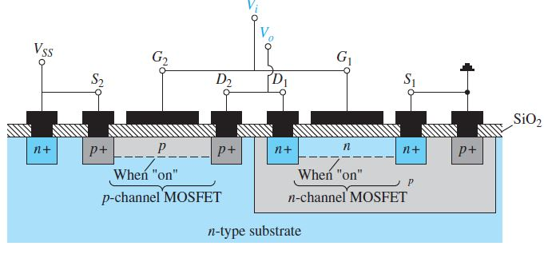
CMOS Devices
A very effective logic circuit is created by constructing a p -channel and an n -channel MOSFET on the same substrate as shown below.
Device with induced p -channel on the left and the induced n -channel on the right is referred to as a complementary MOSFET arrangement (CMOS). It has extensive applications in computer logic design.
Relatively high input impedance, fast switching speeds, and lower operating power levels of the CMOS configuration are the hallmarks of CMOS logic design.
A very effective use of the complementary arrangement is as an inverter discussed in the next slide.

Slide 16
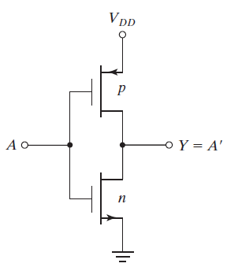
Points To Remember for Operation of CMOS Devices
To understand the operation of the CMOS type device, following behavior of the MOS transistors must be kept in mind:
1. The n ‐channel MOSFET conducts when its gate‐to‐source voltage is positive.
2. The p ‐channel MOSFET conducts when its gate‐to‐source voltage is negative.
3. Either type of device is turned off if its gate‐to‐source voltage is zero.
CMOS Device - NOT Gate
Operation of the Inverter (NOT Gate):
When the input is low (A=0), both gates are at zero potential. The input is at negative potential relative to the source of the p ‐channel device, turning the p-device On. For the n-type device, the input is at 0 V relative to the source of the n ‐channel device, thus turning it Off.
Under these conditions, there is a low‐impedance path from V_{DD} to the output and a very high impedance path from output to ground. Therefore, the output voltage approaches the high level V_{DD} under normal loading conditions.
When the input is high (A=1), both gates are at V_{DD} and the situation is reversed: The p ‐channel device is off and the n ‐channel device is on. The result is that the output approaches the low level of 0 V.

Slide 17
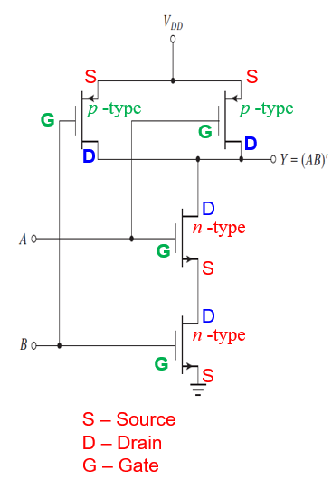
CMOS Devices - NAND Gate
A two‐input NAND gate consists of two p ‐type units in parallel and two n ‐type units in series, as shown here.
If both inputs, A & B, are high (A=B=1). Both p ‐channel transistors turn off ,
and both n ‐channel transistors turn on.
The output Y has a low impedance to ground and
produces a low state.
If any input is low (say A=1 and B=0), the associated n ‐channel transistor is turned off
and the associated p ‐channel transistor is turned on.
The output is coupled to V_{DD} and goes to the high state.
Multiple input NAND gates may be formed by placing equal numbers of p ‐type and n ‐type transistors in parallel and series, respectively, in an arrangement similar to as shown here.

Slide 18
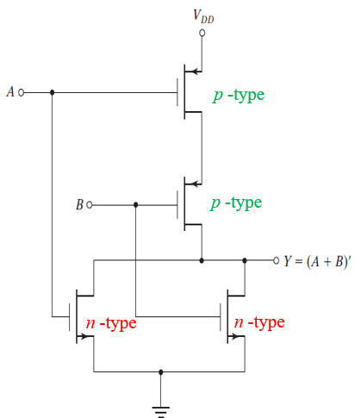
CMOS Devices - NOR Gate
A two‐input NOR gate consists of two n ‐type units in parallel and two p ‐type units in series, as shown here.
When all inputs are low (A=0 and B=0),
both p ‐channel units are on
and both n ‐channel units are off.
The output is coupled to V_{DD} and goes to the high state.
If any input is high (say A=0 and B=1),
The associated p ‐channel transistor is turned off
and the associated n ‐channel transistor turns on, connecting the output to ground and causing a low‐level output.

Slide 19
Operational Amplifiers
Chapter-10: Operational Amplifier
Electronic Devices & Circuit Theory by Boylestad and Nashelsky

Slide 20
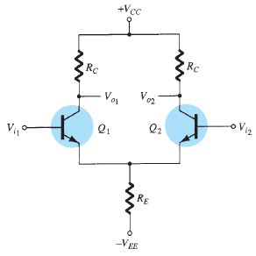
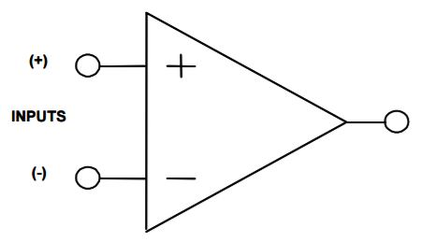
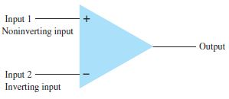
Operational Amplifiers
An operational amplifier is a very high gain differential amplifier with high input impedance (few MΩ) and low output impedance (< 100 Ω).
Typical uses of the operational amplifier is to provide:
  voltage amplitude changes (amplitude and polarity),
  oscillators, filter circuits, and many types of instrumentation circuits.
Differential Amplifier
An op-amp contains a number of differential amplifier stages to achieve a very high voltage gain.
Symbol of an Operational Amplifier is shown here.
The basic circuit is made using a difference amplifier having two inputs (plus and minus) and at least one output.
  The plus (+) input (Non-Inverting) produces an output that is in phase with the signal applied.
  The minus (-) input (Inverting) results in an opposite-polarity output.

Slide 21
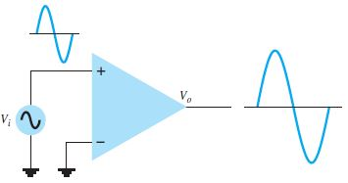
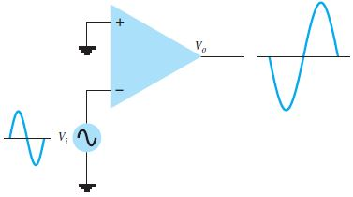
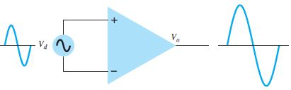
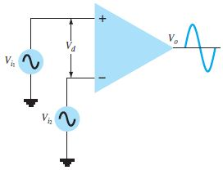
Operational Amplifiers
- Types of Operations
Single-ended Input Operation
When the input signal is connected to one input with the other input is grounded.
  If the input is applied to the plus (+) input, output will have the same polarity as the applied input signal.
  If the input signal is applied to the minus (-) input, the output will have opposite polarity to the applied signal.
Double-ended (Differential) Input
Input signals are applied at both, inverting as well as non-inverting, inputs and this is referred to as double-ended operation.
Input Signal V_{d} applied between the two input terminals results in an amplified output signal V_{O} , which is in phase with the input signal.
If two separate signals V_{i1} & V_{i2} are applied at the inputs, the difference signal V_{i1} – V_{i2} gets amplified as output signal V_{O}, which is in phase with the input signal.

Slide 22
Attributes of an Ideal Op Amp
An ideal op-amp circuit has infinite input impedance, zero output impedance, and infinite voltage gain. A summary of ideal Op Amp attributes is given below:
  IDEAL OP AMP ATTRIBUTES
    Infinite Differential Gain
    Zero Common Mode Gain
    Zero Offset Voltage
    Zero Bias Current
    Infinite Bandwidth
  OP AMP INPUT ATTRIBUTES
    Infinite Impedance
    Responds to Differential Voltages
    Does not Respond to Common Mode Voltages
  OP AMP OUTPUT ATTRIBITES
    Zero Impedance

Slide 23
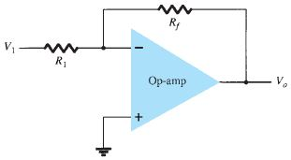
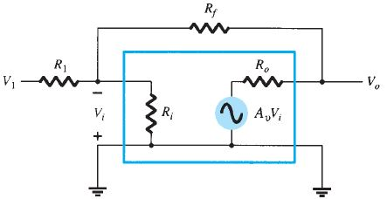
Basic Op Amp
The basic op-amp acts as a constant-gain multiplier.
An input signal V₁ is applied through resistor R₁ to the (-) input. The output is fed back to the same (-) input through resistor R_{f} .
The (+) input is connected to ground.
Since the input signal is at the (-) input, the resulting output V₀ is opposite in phase to the input signal.
The ac equivalent circuit of op amp has R_{i} as input resistance and R_{o} as output resistance.

Slide 24

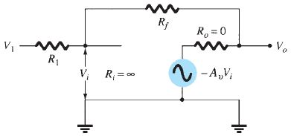
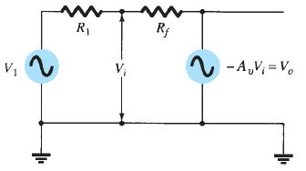

Basic Op Amp
The basic circuit connection using an op-amp is shown here.
The circuit provides operation as a constant-gain multiplier.
An input signal V₁ is applied through resistor R₁ to the minus input.
Output is connected back to the same minus input through resistor R_{f} .
Plus (+) input is connected to ground.
Input Signal V₁ is applied to the minus input, the resulting output is opposite in phase to the input signal. Figure below shows the op-amp replaced by its ac equivalent circuit.
The ac equivalent circuit of op amp has R_{i} as input resistance and R_{o} as output resistance.
In an ideal op-amp equivalent circuit – R_{i} is replaced by an infinite resistance and R_{o} by a zero resistance.
The Gain of this op amp network is given as A_{V} = v
← Negative sign indicates that output signal is 180 degrees out of phase with input signal.
Redrawing the equivalent circuit:-

Slide 25
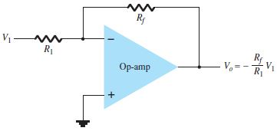
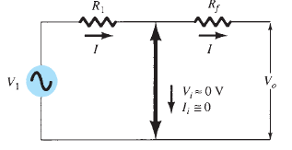

Virtual Ground
In an Operational Amplifier, voltage gains are very high, can be of the order of several 1000.
However, the output voltage of an Op-Amp is limited by its supply voltage, typically, a few volts.
Example: If V_{O} = -10 V and Av = 20,000, then input voltage is
Drawing the equivalent diagram of the above network, we have
Compared to all other input and output voltages in the circuit, the value of V_{i} is then small and may be considered 0 V.
If the circuit has an overall gain (V_{O} /V₁) of, say, 1, the value of V₁ is 10 V.
Note that although V_{i} ≈ 0 V, it is not exactly 0 V. (The output voltage is a few volts
due to the very small input V_{i} times a very large gain A_{v})

Slide 26


Virtual Ground
If V_{i} is taken to be ≈ 0 V, this leads to the concept that at the amplifier input there exists a virtual short-circuit or virtual ground.
Virtual short implies that
  although the voltage is nearly 0 V, but actually there is no current through the amplifier input to ground. This implies that the inverting and non-inverting inputs of the amplifier have virtually the same potential.
  Figure depicts the virtual ground concept. The heavy line indicates that a virtual short exists with V_{i} ≈ 0 V but that this is a virtual short so that no current goes through the short to ground. Current goes only through resistors R₁ and R_{f} as shown. Using the virtual ground concept, equations for the current I is as follows:
and this can be used to solve for voltage gain:

Slide 27


Basic Op Amp
Unity Gain
Voltage gain =
If R_{f} = R₁ then Voltage gain = -1
Circuit provides a unity voltage gain with 180° phase inversion.
Constant-Magnitude Gain
If R _{f} is some multiple of R₁, and the overall amplifier gain is a constant. For example, if R_{f} = 10R₁, then
Voltage gain = - R_{f} / R₁ = -10
Circuit provides a voltage gain of 10 with a 180° phase inversion from the input signal.
Selection of precise values of R_{f} and R₁ can provide wide range of gains.
The gain is as accurate as the resistors used and is only slightly affected by temperature and other circuit factors.

Slide 28

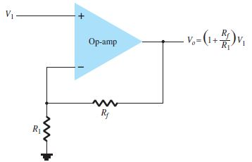

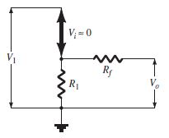

Practical Op Amp Circuits
Inverting Amplifier
The most widely used constant-gain amplifier circuit is the inverting amplifier.
The output is obtained by multiplying the input by a fixed or constant gain, fixed by the input resistor ( R₁ ) and feedback resistor ( R_{f} ).
This output is in inverted form with respect to the input.
Non-Inverting Amplifier:
Non-inverting amplifier or Constant-Gain multiplier circuit is shown here.
To determine voltage gain, equivalent representation is used.
Voltage across R₁ is V_{1,} with V_{i} =0 V,
Use voltage divider of R₁ and R_{f} ,to get V₁
This results in:-

Slide 29
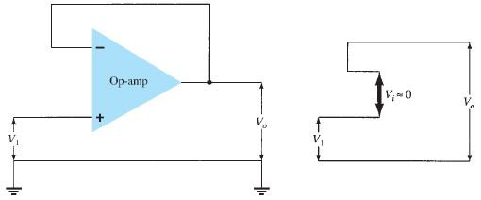
Practical Op Amp Circuits – Unity Follower
Unity Follower:
The unity-follower circuit, shown below provides a gain of unity (1) with no polarity or phase reversal. From the equivalent circuit, it is clear that
V_{o} = V₁
The output is of same polarity and magnitude as the input. The circuit operates like an emitter- or source-follower circuit except that the gain is exactly unity.

Slide 30

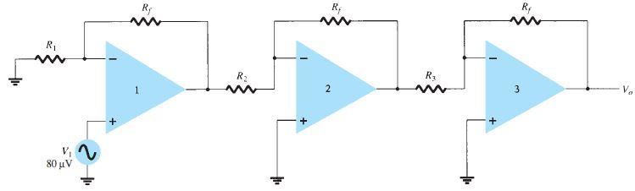
Multi-Stage Gains
When a number of stages are connected in series, the overall gain is the product of the individual stage gains.
Figure below shows a connection of three stages. The first stage is connected to provide non-inverting gain as given by Equation A₁ = 1+ (R_{f} / R₁).
Next two stages provide an inverting gain of A₂ = -(R_{f} / R₂) and A₃ = -(R_{f} / R₃) respectively. The overall circuit gain is then calculated by taking the product of gain of individual stages: A = A₁.A₂.A₃

Slide 31

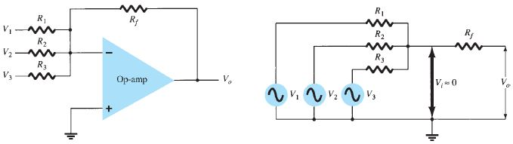
Practical Op Amp Circuits
Summing Amplifier
A 3-Input Summing Amplifier Circuit is shown below.
The equivalent representation shown below can be used to show the output voltage expressed in terms of the inputs.
Each input adds a voltage to the output multiplied by its separate constant-gain multiplier. If more inputs are used, each adds an additional component to the output.
Consequently, it provides algebraic sum (addition) of three input voltages, each multiplied by a constant-gain factor.

Slide 32
End

